Slide 1
Sentiment classification based on transfer learning and construction of quantitative investment strategy
—— Using crawler technology to take the sentiment forum of the
stock bar forum as the data set
YANG MINGTONG (A0215616J)
WANG YUZHOU (A0215604N)
YOU YOU (A0215652J)
ZHANG SIQI (A0215622N)
CHEN SIYU (A0215603R)

Slide 2
CONTENT
Research theme and significance
Theoretical basis and related literature review
Web crawler technology crawls stock forum text information
PART ONE
PART TWO
PART THREE
Data cleaning and preprocessing
Sentiment Index construction & Quantitative strategy construction and evaluation
Sentiment Index construction & Quantitative strategy construction and evaluation
Summary
PART FIVE
PART FOUR
PART FIVE
PART SIX

Slide 3
Research theme and significance
PART ONE

Slide 4
PART ONE Research theme and significance
Research theme
This project uses crawler technology to crawl the stock bar forum data, and tried different sentiment classification algorithms. Then we adopted a more advanced transfer learning technology in natural language processing, which made up for the shortcomings of the smaller data set and achieved relatively accurate forecast. Based on the fine-tuned model to establish sentiment indicators, we construct a quantitative investment strategy, after historical back-testing, it has achieved a relatively excellent investment performance.

Slide 5
PART ONE Research theme and significance
Web crawler fetches stock forum text information
Data reviewing, cleaning and preprocessing
Finally, get the data with the timestamp and comment
Sentiment Analysis Based on Sentiment Dictionary
Word splitter and set stop words
Sentiment Classification Model
Sentiment Analysis based on Deep Learning
(Word2Vec +Bi-LSTM Model)
Sentiment Index Construction
Transferring Learning Based on Ernie
Quantitative strategy construction and evaluation

Slide 6
PART ONE Research theme and significance
For quantitative investors, sentiment index can be constructed and use to predict stocks to achieve excess earnings.
For regulators, they should pay attention to monitor the amount of posts and the mood of posts：
-Securities market regulatory authorities can get a prophetic message about
future stock price fluctuations in a relatively easy-monitorring environment
such as stock Internet forums.
-Before the stock price fluctuates violently, appropriate measures can be taken
to guard against the risk of a sharp rise or a sharp fall in the stock price.

Slide 7
Theoretical basis and related literature review
PART TWO

Slide 8
PART TWO Theoretical basis and related literature review
Basic theory
1.Representativeness (heuristic)
bias
2.Dynamic overconfidence
Short-term rise further noise investors' faith, at the same time according to the ideas of game theory, rational investors will forecast the market the most optimistic state, and therefore to participate in the game, which high price increase momentum, the market will reflect the price of the most optimistic, but due to its deviation from the company fundamentals, long-term will reverse the trend.
From the perspective of behavioral finance
Due to representativeness bias of investor psychology, stock price overreacts to information, and investor sentiment has a negative impact on stock returns.
3.Limited attention
4.Market imperfection
Most individual investors do not have the ability to research all the stocks before making a purchase decision. Instead, they simply choose from among the stocks that are highly attracting their attention. This increase in attention will exert upward price pressure on the stock in the short term, followed by a reversal.
There is an objective restriction on short selling in China's stock market, which makes the time lag for bearish forces to enter the market price.

Slide 9
Web crawler technology crawls stock forum text information
PART THREE

Slide 10
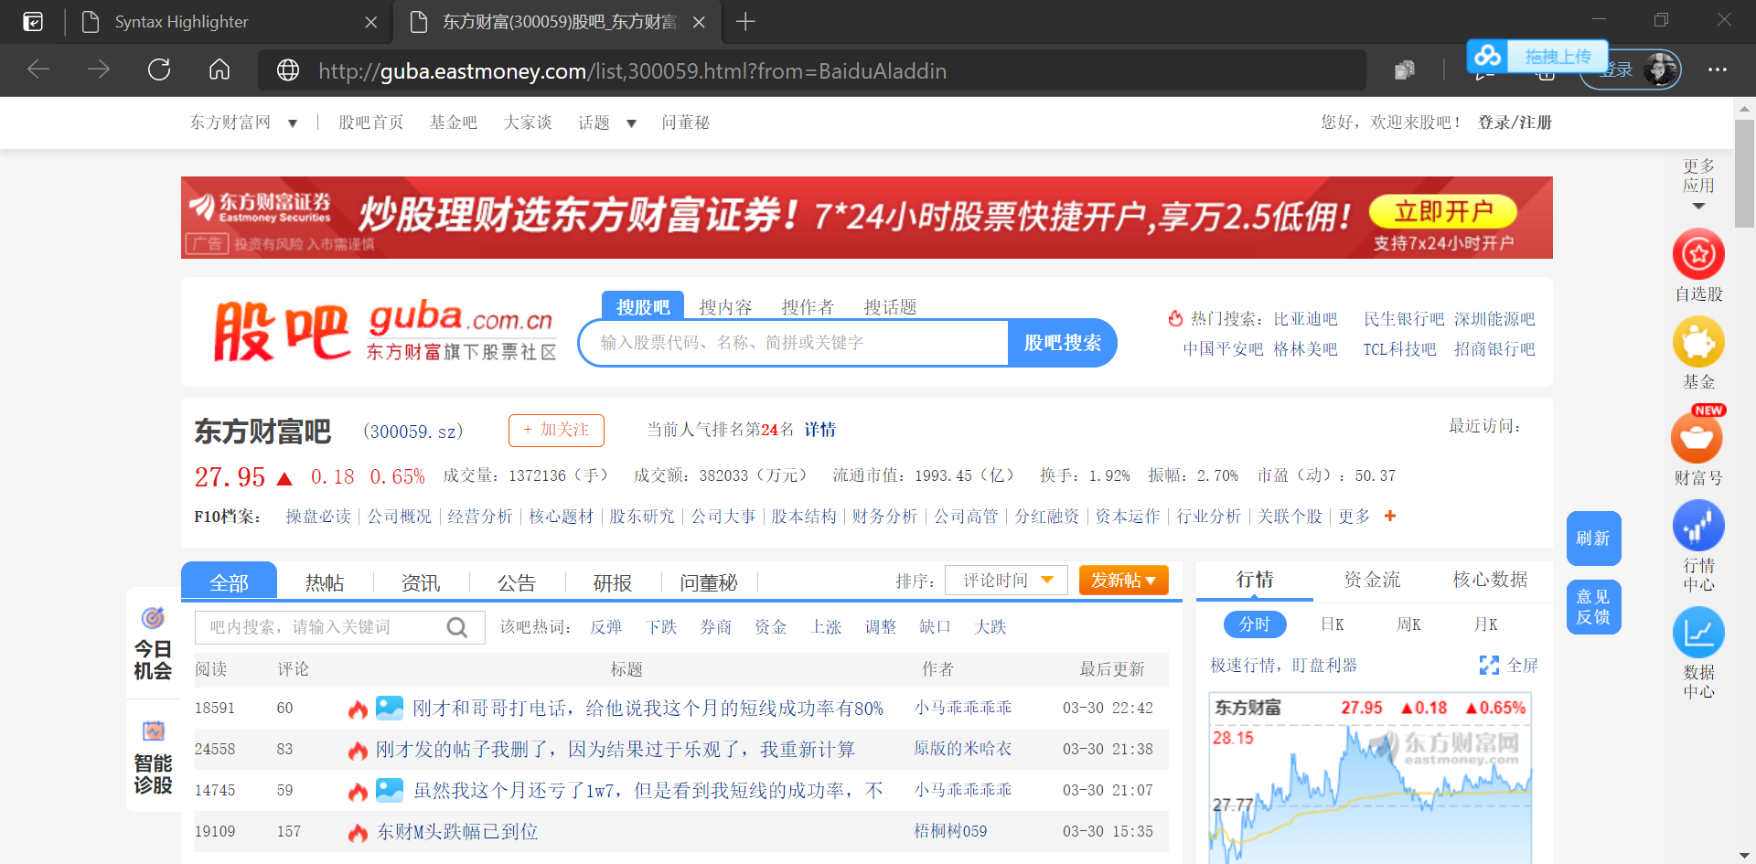
PART THREE Web crawler technology crawls stock forum text information
The data comes from the stock comment data of 30 of Shanghai stock 50ETF (SH50ETF) in the stock bar forum of DONG FANG CAI FU in the past three years, with a total of 1.1 million posts.
The crawler adopts the scrapy framework, starting from the home page of the designated stock bar, turning the page in a circle and recording the post hyperlinks, and then distributing tasks according to each link to obtain the relevant information of all posts.
The information content of a single post includes multiple data such as time, text content, number of comments, number of readings, number of likes, and information of the poster, etc. The report will finally store it in the MongoDB database in the format of JSON.

Slide 11
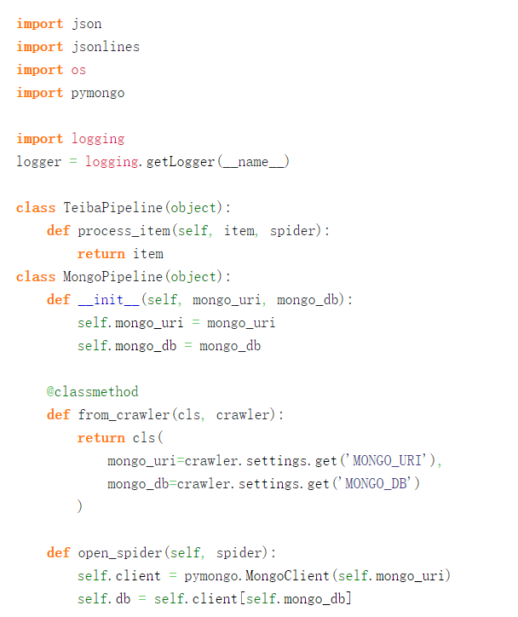
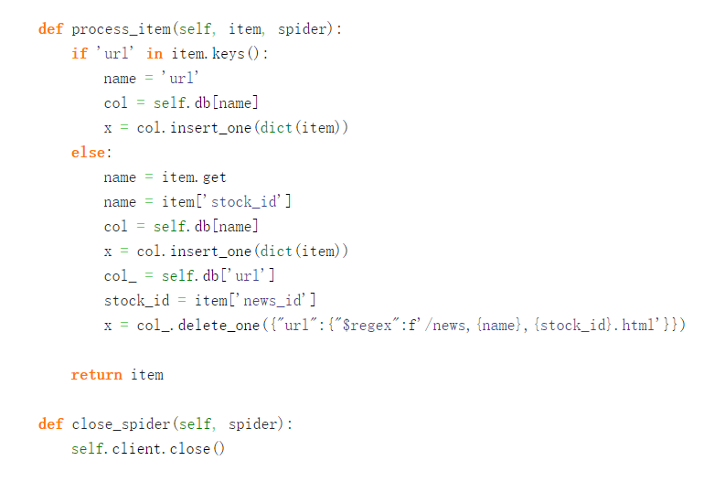
PART THREE Web crawler technology crawls stock forum text information
Part of the codes, not entirely

Slide 12
Data cleaning and preprocessing
PART FOUR

Slide 13
PART FOUR Data cleaning and preprocessing
After obtaining the original data, three aspects of data cleaning and pretreatment are mainly carried out for the comments.
From the time dimension, considering the opening date and closing time of the stock market, the posts were divided and merged.
From the stock dimension, only 30 of Shanghai stock 50ETF (SH50ETF) were considered for investor comments, and irrelevant information was deleted.
From the dimension of text content, unify the format of data, including removing emoticons, pictures and table contents, as well as deleting meaningless noisy posts.
Considering that the follow-up will be used to construct the quantitative investment strategy, the time for Posting on the forum is reserved; At the same time, due to the need to construct a training set for the subsequent deep neural network training, part of the data were manually labeled, so the format of the final data was: timestamp + forum text comment + corresponding artificial emotion classification label.

Slide 14
Sentiment Index construction & Quantitative strategy construction and evaluation
PART FIVE

Slide 15


PART FIVE Sentiment Index construction & Quantitative strategy construction and evaluation
1
Sentiment Analysis Based on Sentiment Dictionary
Sentiment Index Construction
PART
2
Sentiment Analysis based on Deep Learning
(Word2Vec +Bi-LSTM Model)
3
Transferring Learning Based on Ernie

Slide 16
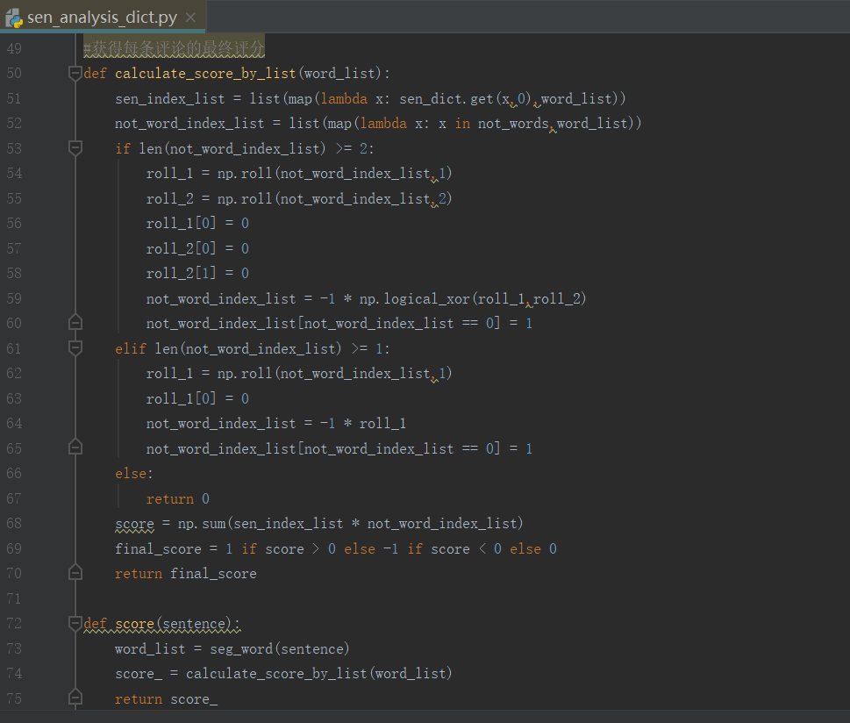

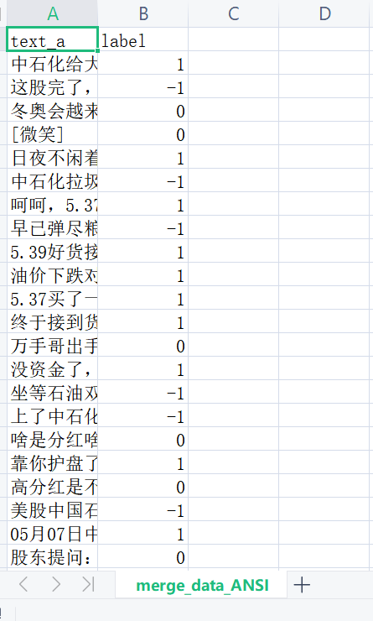
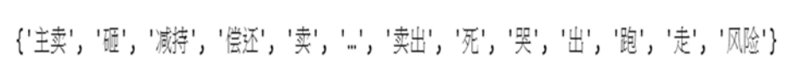
Sentiment Analysis Based on Sentiment Dictionary
Model score
NTUSD Sentiment dictionary
Model | Test set accuracy
NTUSD word count | 44.2%
NTUSD + Artificial word count | 46.1%
Label:
Negative:-1
Positive:1
Neutrual:0
Comment
The accuracy is low. This method relies too much on the construction of the dictionary itself, and the designed algorithm is too rough. Future improvement can be made from two aspects: expanding the dictionary and refining the algorithm.
Artificial supplementary
Positive:
Negative:

Slide 17
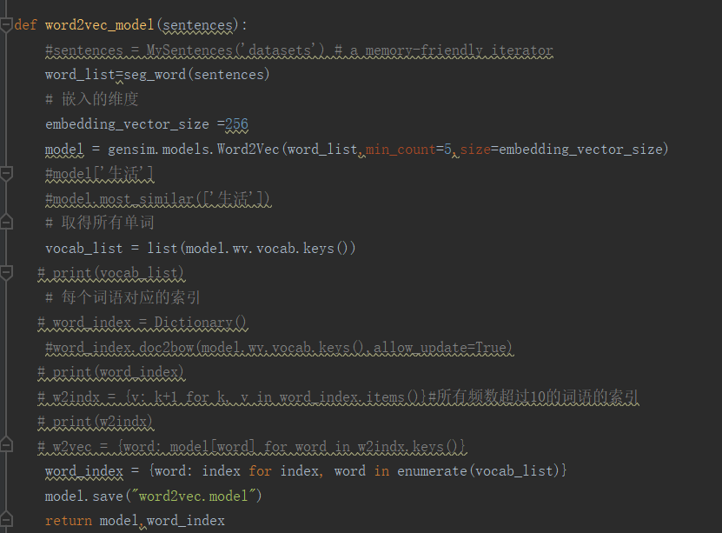
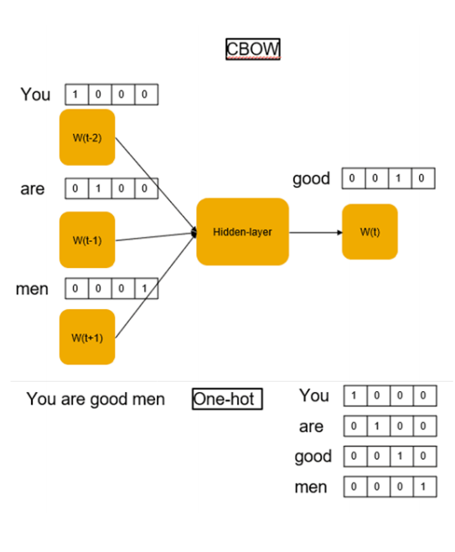
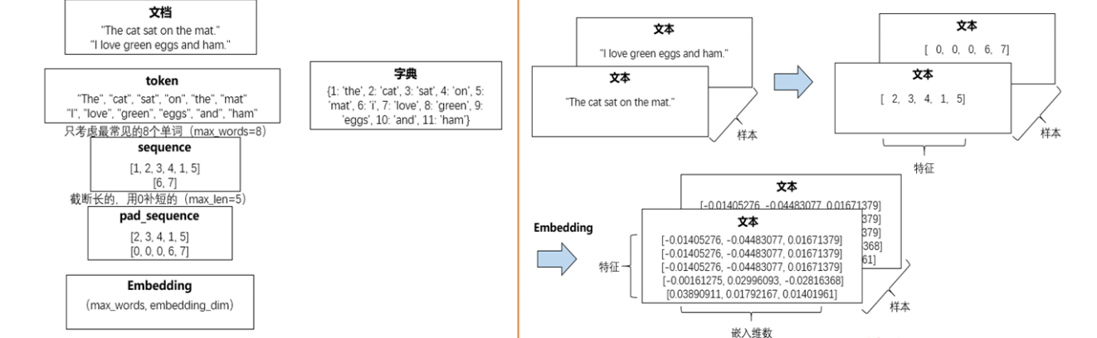
Sentiment Analysis based on Deep Learning (Word2Vec +Bi-LSTM Model)
1
Build word vector Using Word2Vec
Text
Text
Text
dictionary
Text
Text
Only consider the eight most common words
sample
sample
2
Word Embedding
Text
Text
sample
embedded dimension
3
Bi-LSTM(next slide)

Slide 18
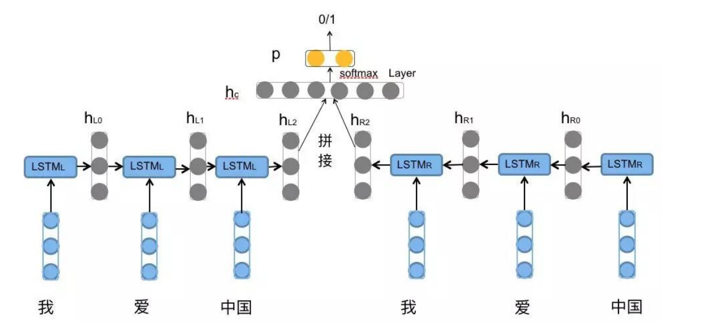
Sentiment Analysis based on Deep —— Bi-LSTM
Tool： extension packages Keras to achieve the following model
Summary：
Training set：3128 items；Testing set：796 items
Input：Content of Netizen Posting
Output：Negative（-1，1754 items），Positive（1，1245 items），Neutral （0，988 items）
Problem Category： Classification problems in supervised learning
JOINT

Slide 19
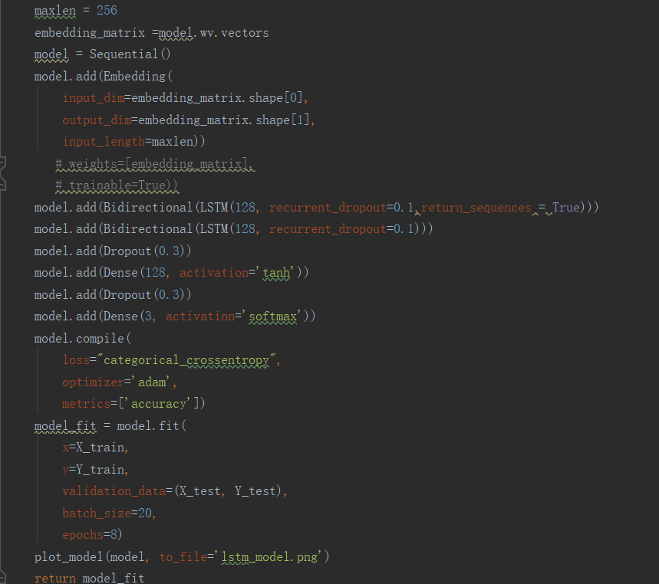
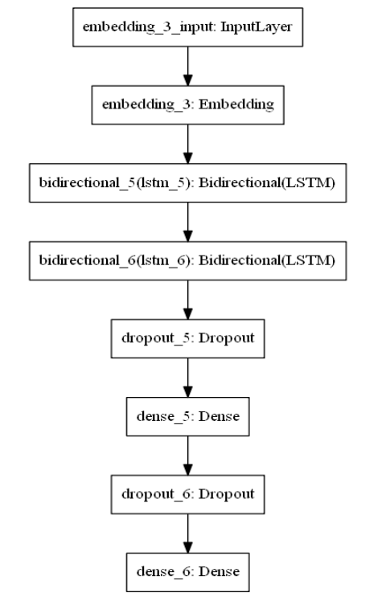
Sentiment Analysis based on Deep Learning—— Bi-LSTM
After parameter debugging, the optimal model architecture selected is as follows:
As shown in the figure , a two-layer bidirectional LSTM model was established in the experiment, with 256+256 neurons, 256+3 neurons in the full connection layer, 0.3 abandonment rate in the Dropout layer, and 8 batches of training

Slide 20
Sentiment Analysis based on Deep —— Bi-LSTM
Results:
Model | Test set accuracy
Word2vec initial weight training | 54.9%
Direct random initial Embedding training | 57.8%
Word2vec initial weight training + Embedding training | 60.3%
By above knowable, the precision of sentiment classification model test set based on deep neural network algorithm has been improved obviously. The precision of the model based on parameter trimming is the highest, which is 60.3%, but also not good enough.
Think about the reason, despite of the model problem, we think the biggest problem is due to the artificial label too time-consuming, we only label the 4000 data group. At the same time, the process of artificial label has the subjective color, so the depth of the advantage of neural network model can not fully revealed.

Slide 21
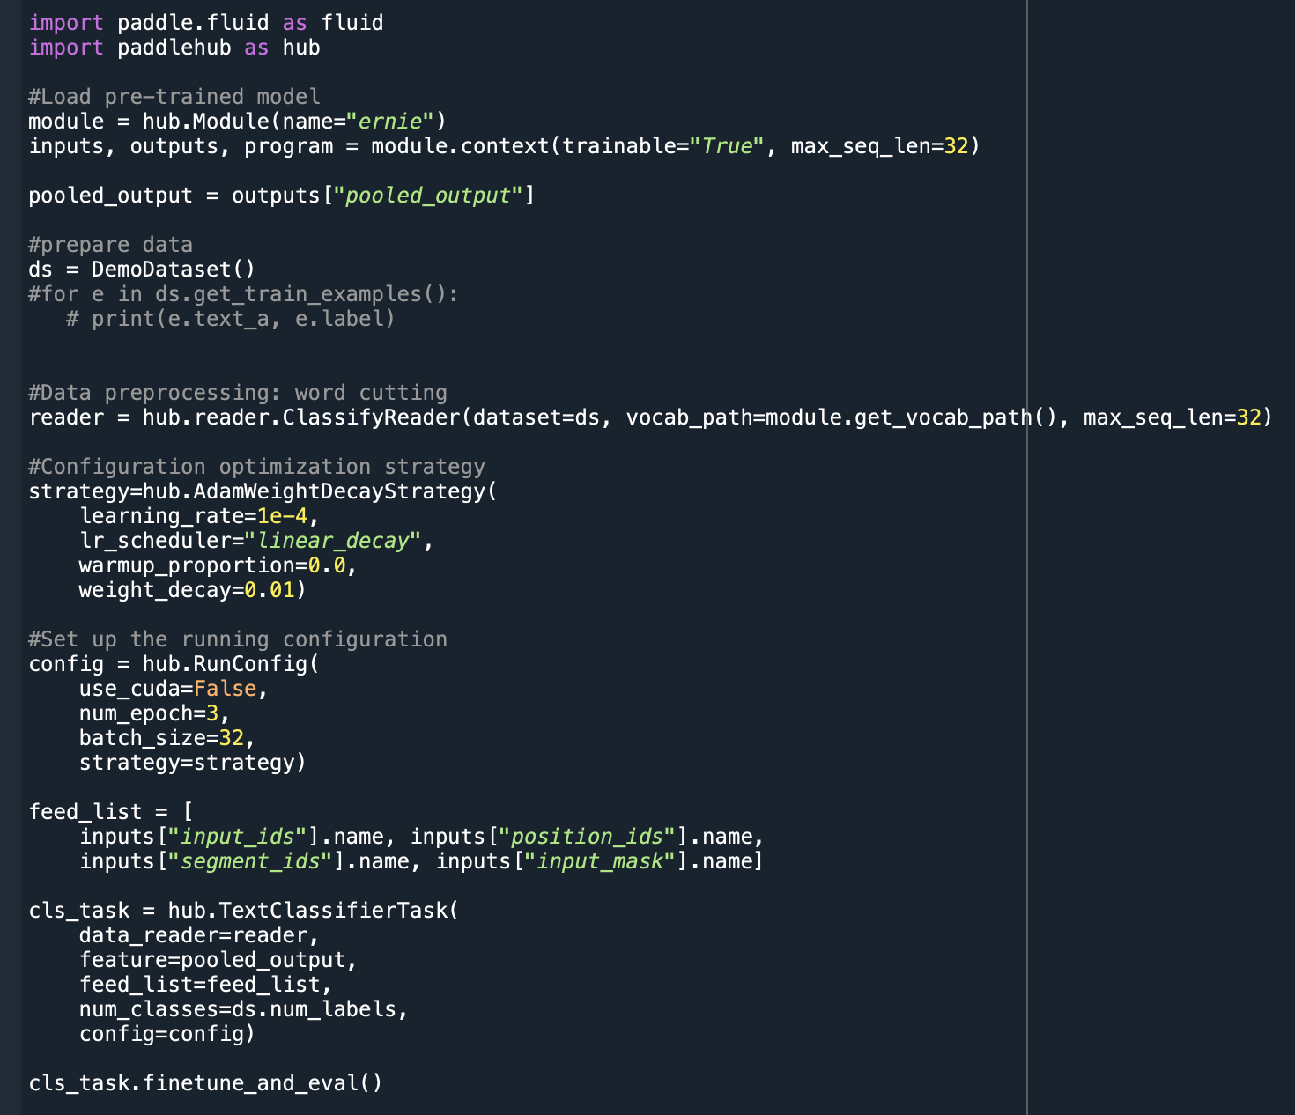
Transferring Learning Based on Ernie
Why Ernie?
Model score
-- Because the data set is not large enough
-- The Transferring Learning is based on a pre-trained model (which trained based on a huge dataset) and further through parameter fine-tuning. This may make up for the lack of data set.
Model | Test set accuracy
Word2vec initial weight training | 54.9%
Direct random initial Embedding training | 57.8%
Word2vec initial weight training + Embedding training | 60.3%
Transferring Learning Based on Ernie | 68.4%
Procedures
1. Load customized data set
Comment
2. Load ERNIE pre-trained model
We used Baidu AI Studio platform and the free GPU on it. Due to this and the parallel processing characteristics of the model, its running speed is much faster than the deep network model. And the accuracy is 68.4%, which is relatively high.
3. Construct Reader
4. Configure strategy
5. Build Fine-Tune to optimize

Slide 22
PART FIVE Sentiment Index construction & Quantitative strategy construction and evaluation
1
Construct Sentiment Index
Quantitative strategy construction and evaluation PART
2
Quantitative strategy
3
Evaluation

Slide 23
Construct Sentiment Index
BullishPosts
NeutralPosts
BearishPosts
BullishSentIndexA: (BullishPosts - BearishPosts) / (BullishPosts + BearishPosts)
BullishSentIndexB: ln(1+BullishPosts)/(1+BearishPosts)
SentConfromIndex: 1 – (1- BullishSentIndexA^2)^0.5
Quantitative strategy
Target: All stocks of SSE A shares
Horizon: 2018~2019
Assumption: All transactions will success, there is no transaction cost, and no minimum purchase limit
Strategy: Divide into five groups according to the single factor value from large to small every day. Short one unit asset of the first group and long one unit asset of the fifth group. And clear the position at the close of the market to get cash back.

Slide 24
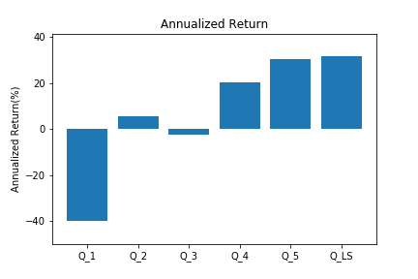
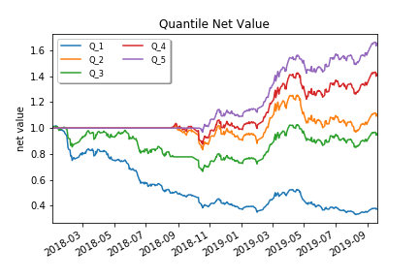
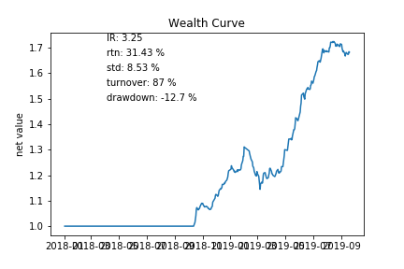
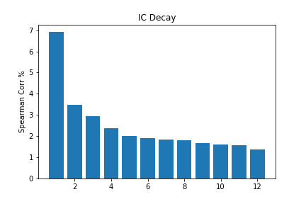
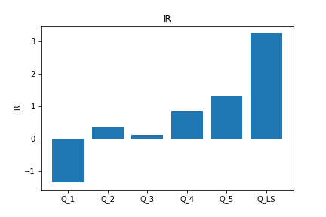
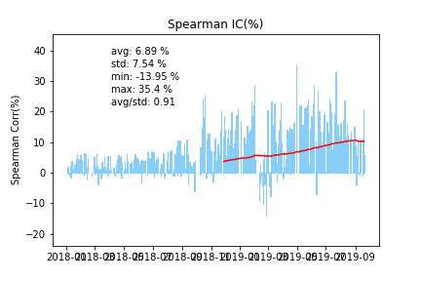
Evaluation
Back test – BearishPost

Slide 25
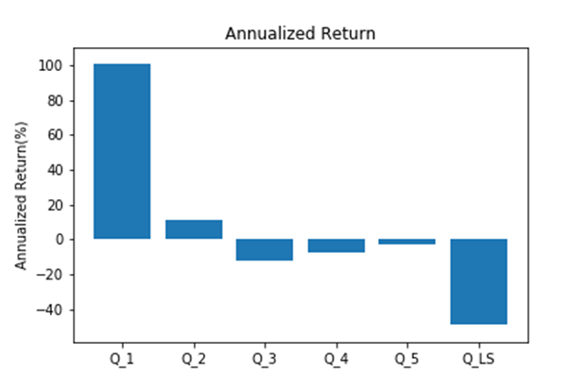
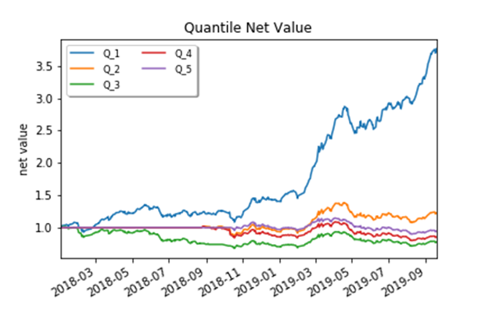
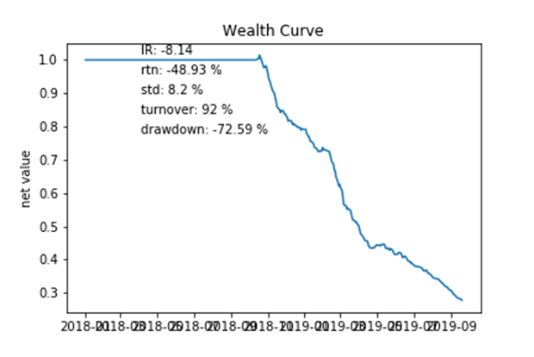
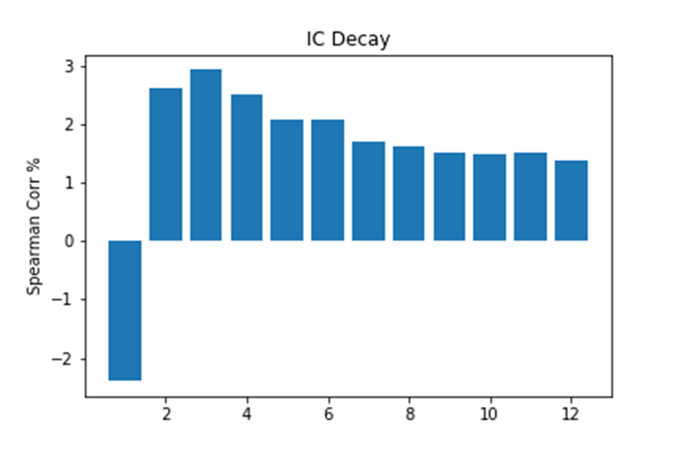
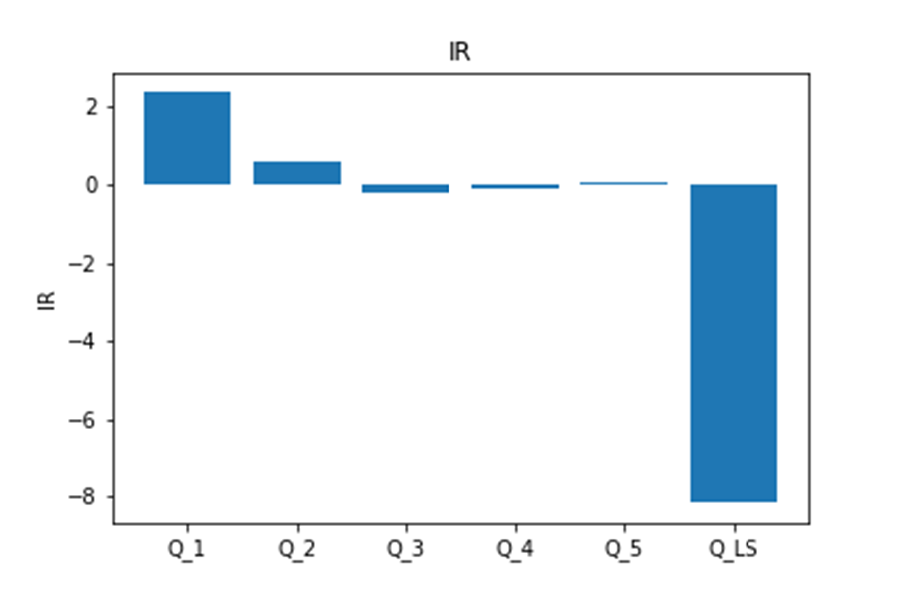
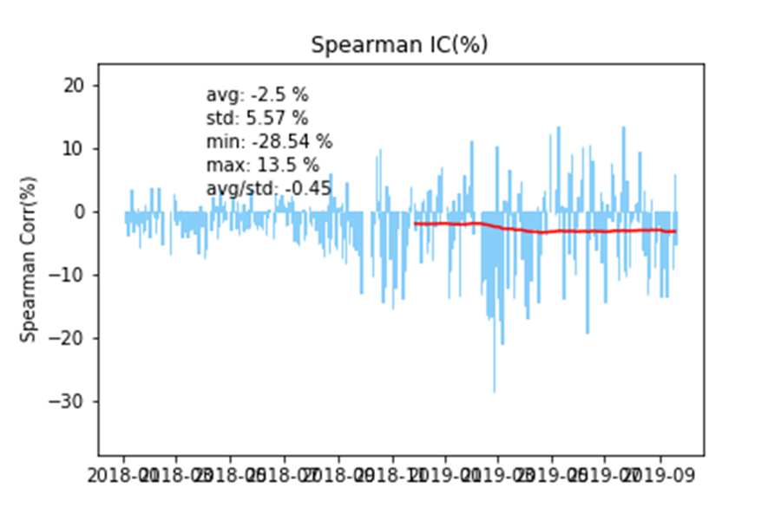
Evaluation
Back test – BullishPost

Slide 26
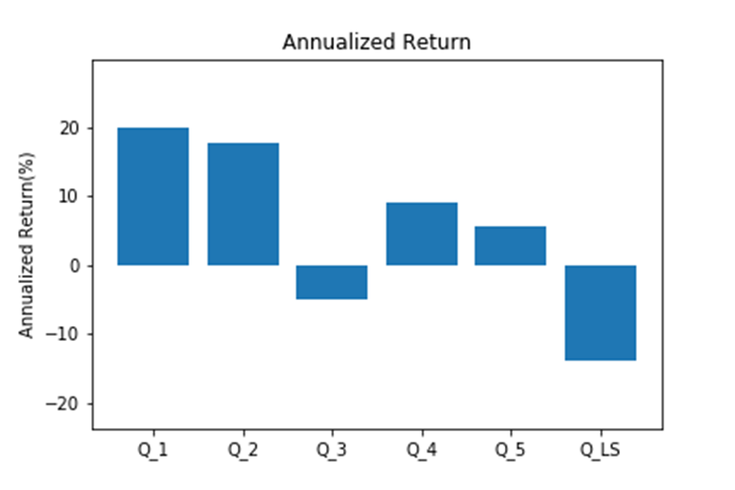
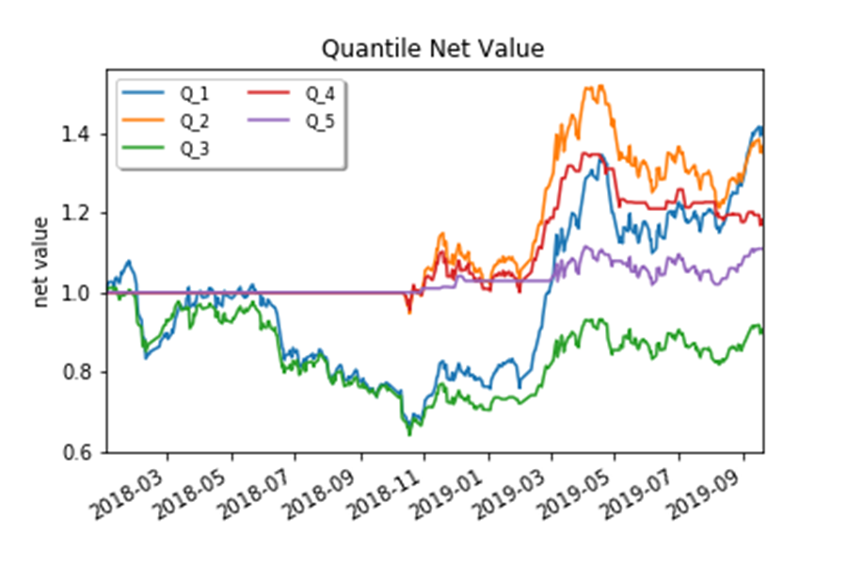
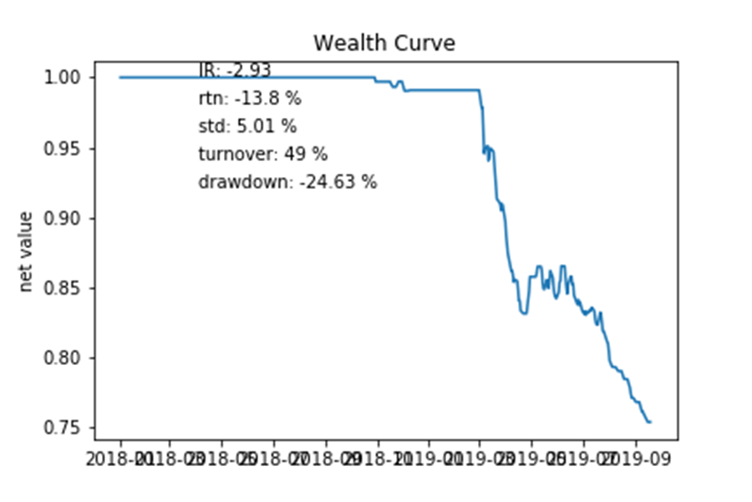
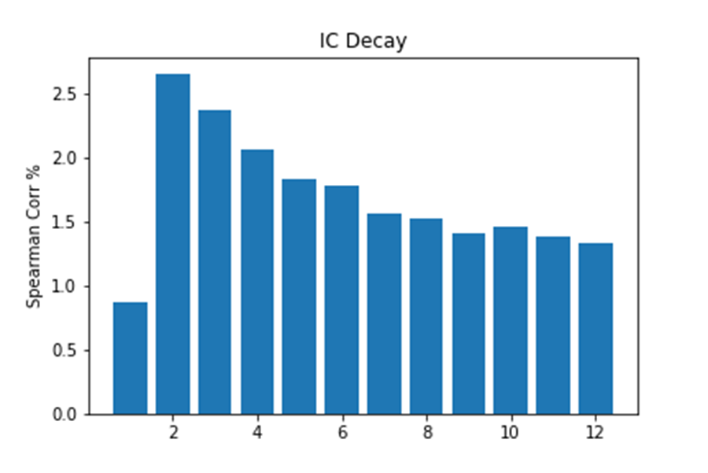
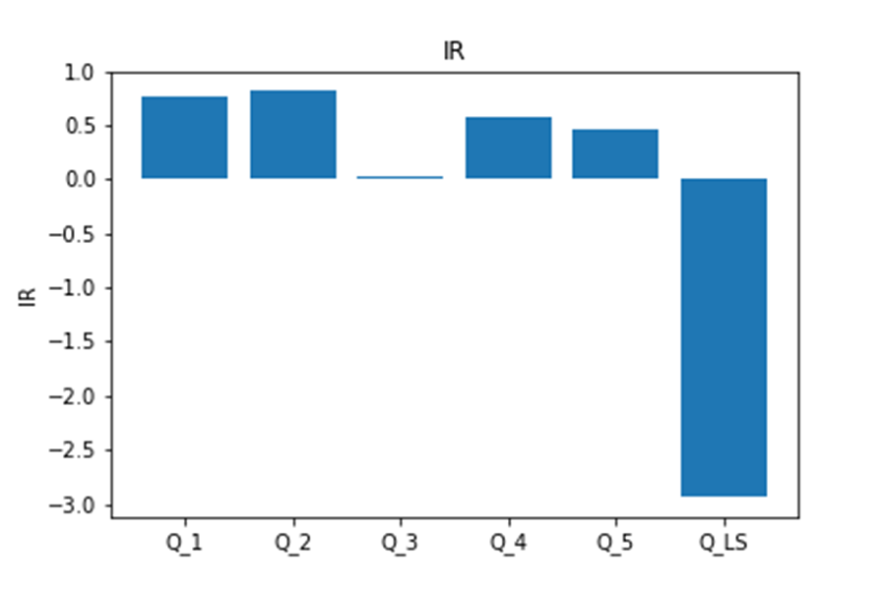
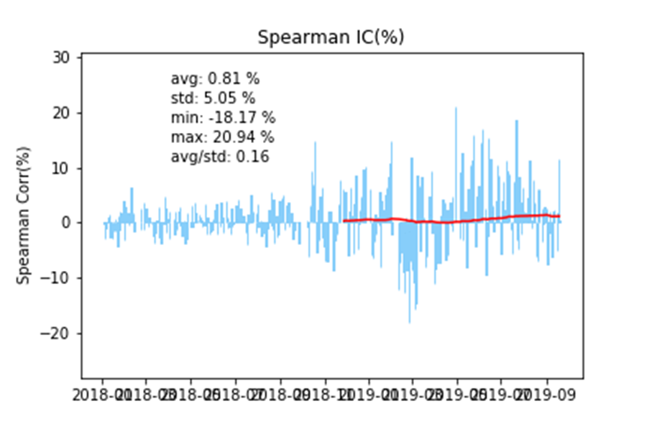
Evaluation
Back test – NeutralPost

Slide 27
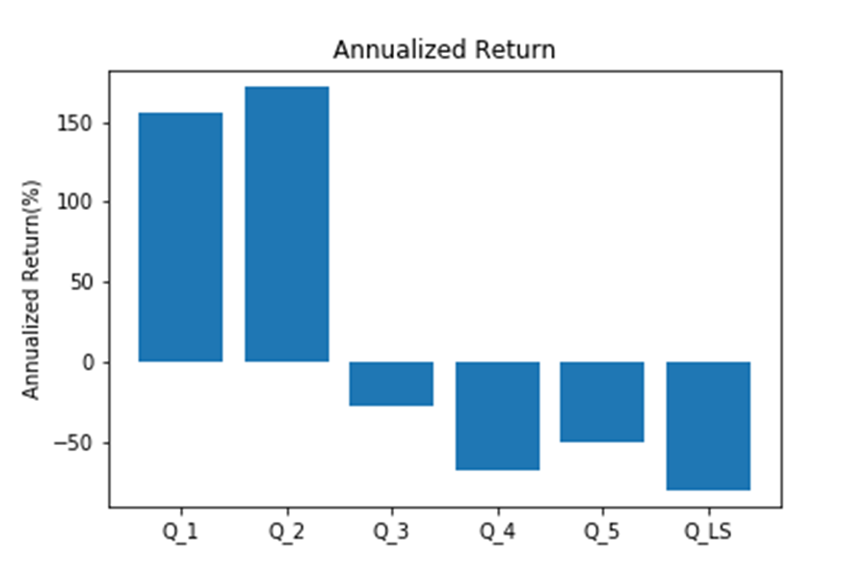
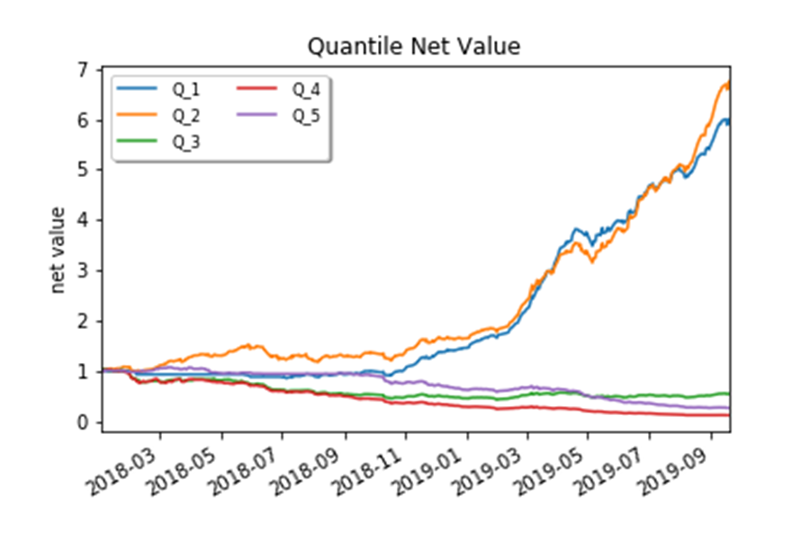
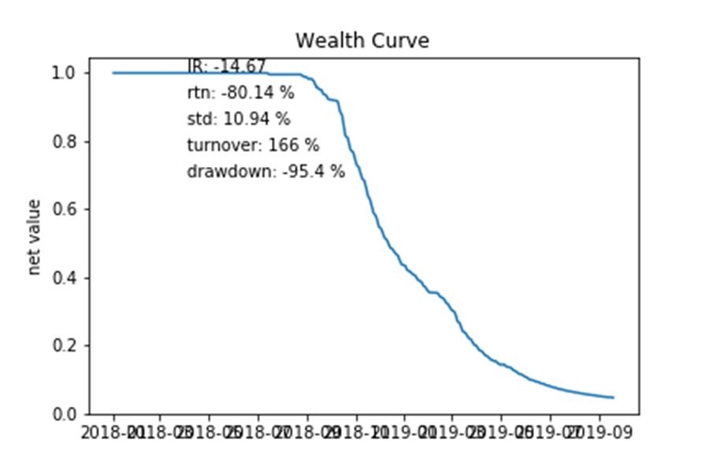
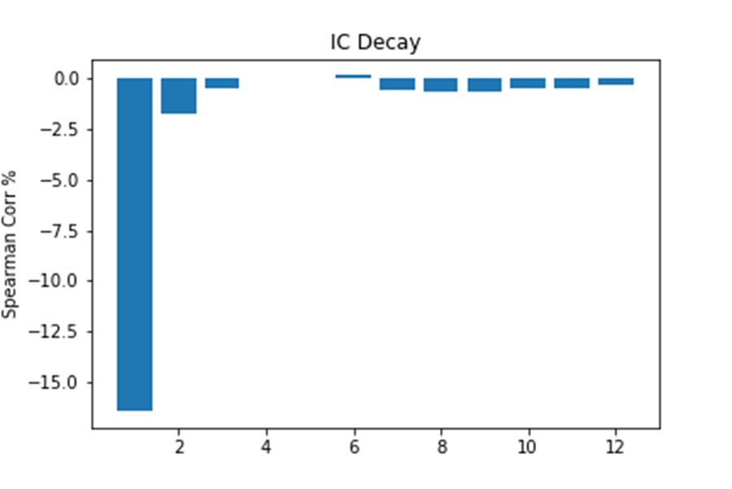
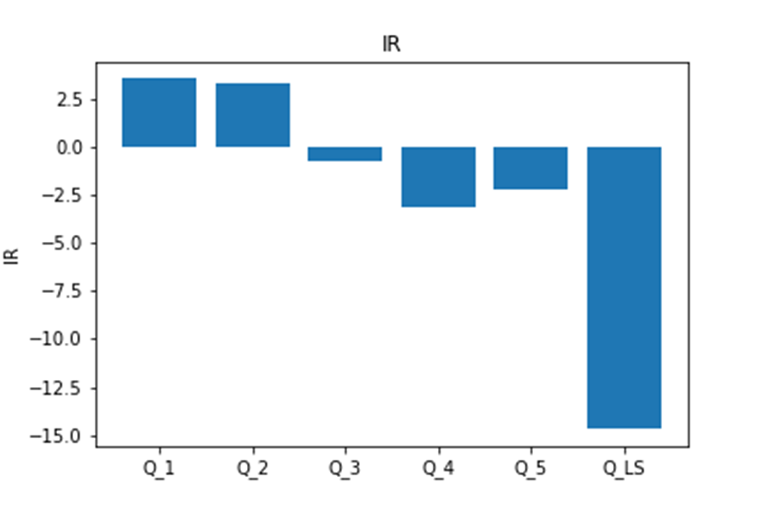
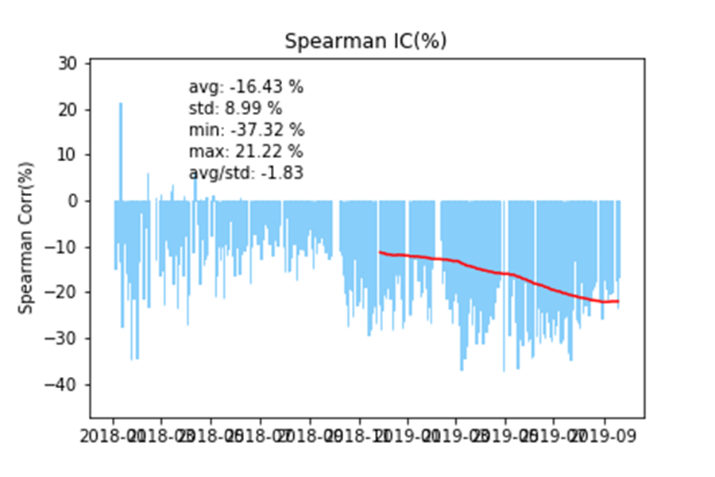
Evaluation
Back test – Sentiment_A

Slide 28
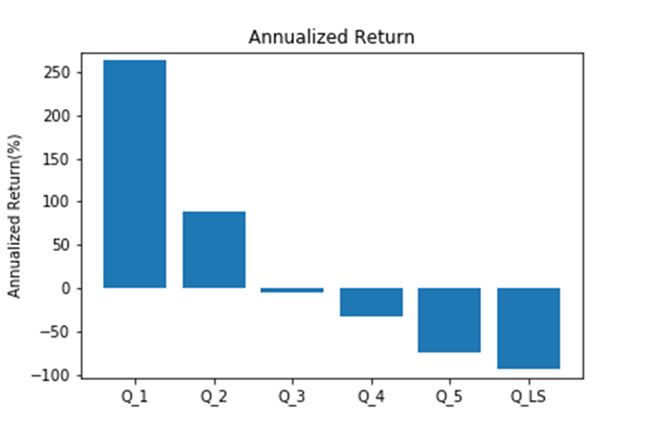
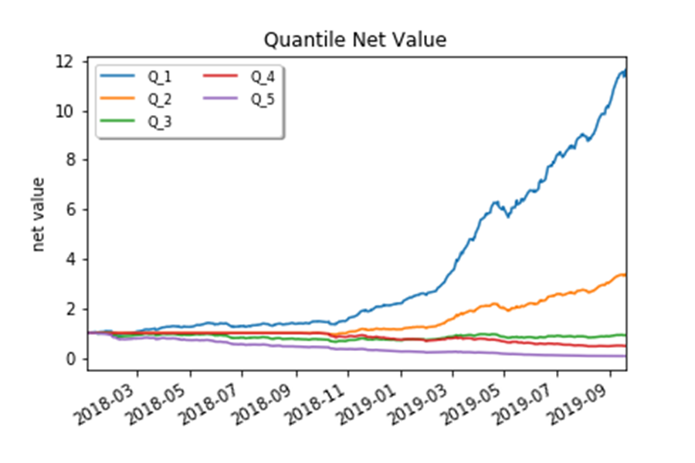
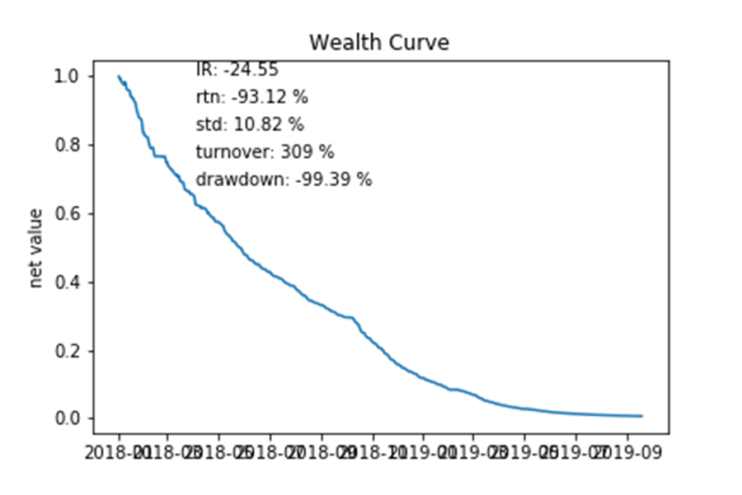
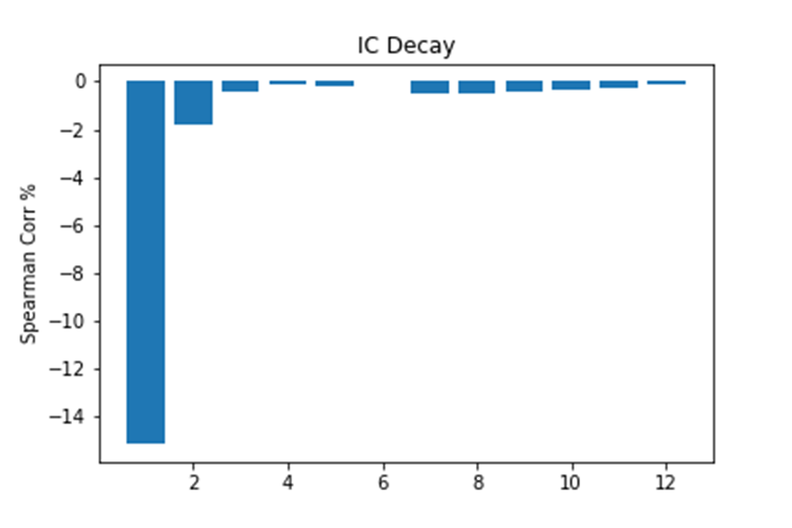
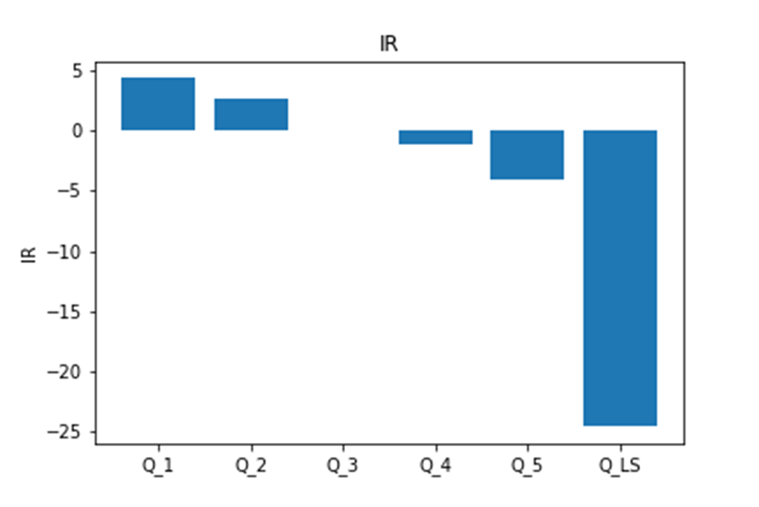
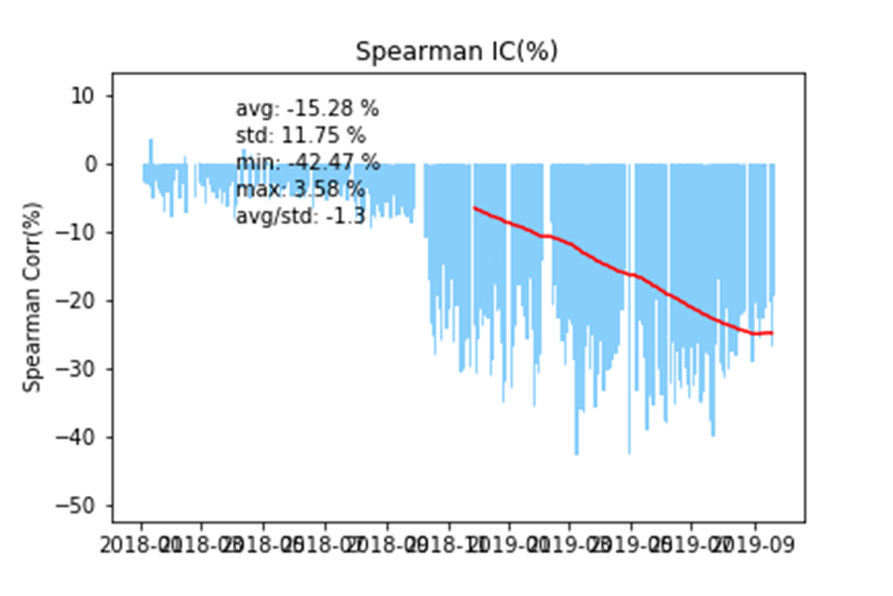
Evaluation
Back test – Sentiment_B

Slide 29
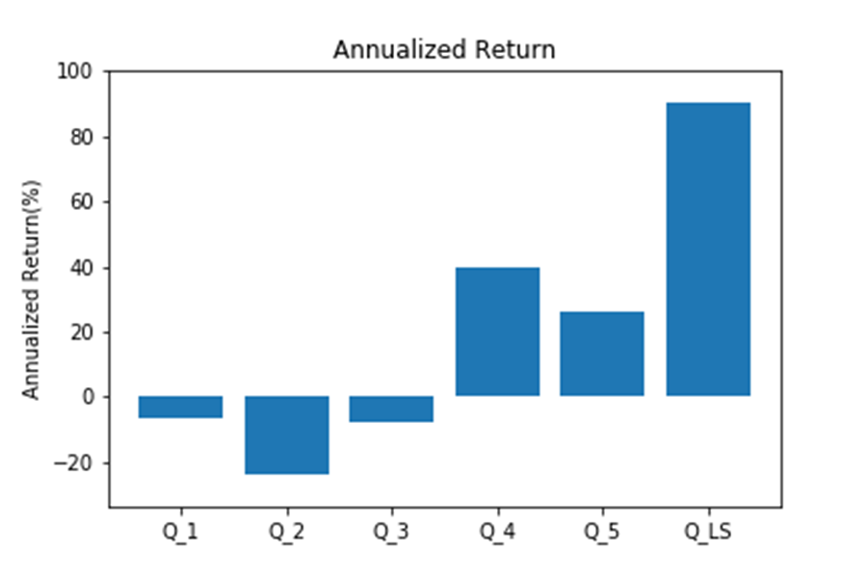
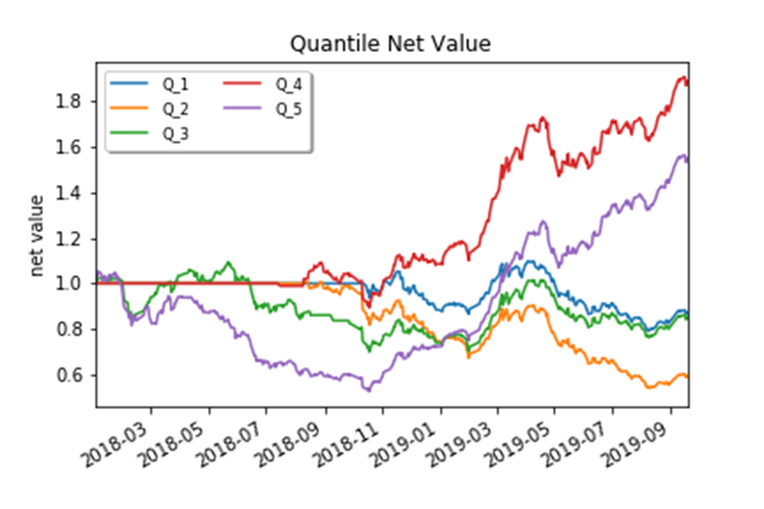
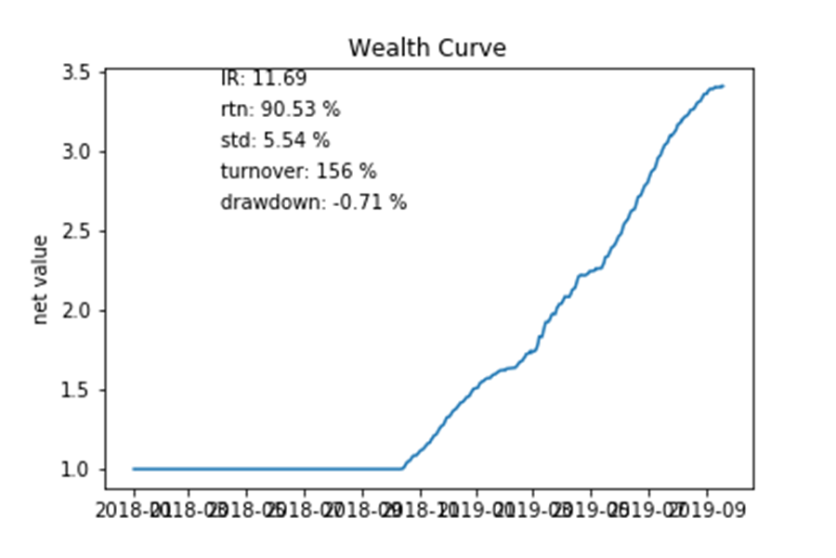
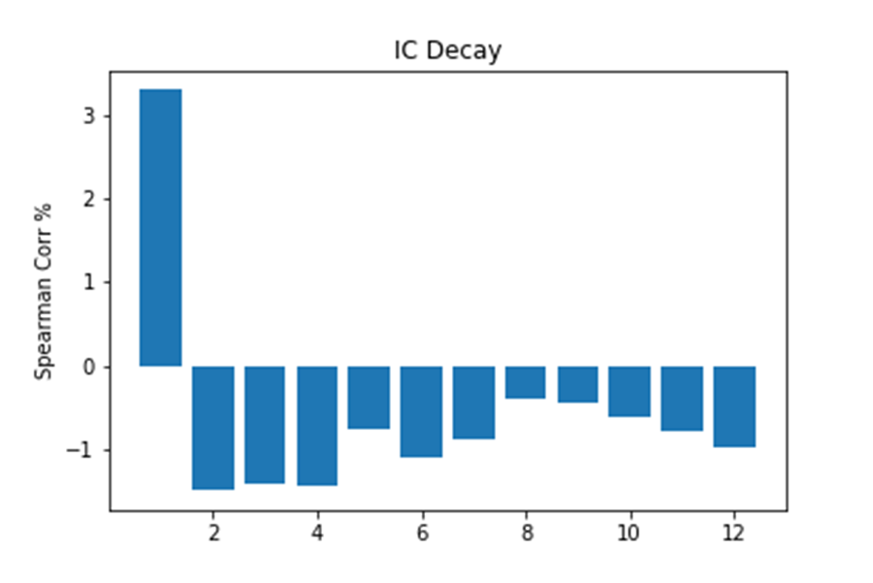
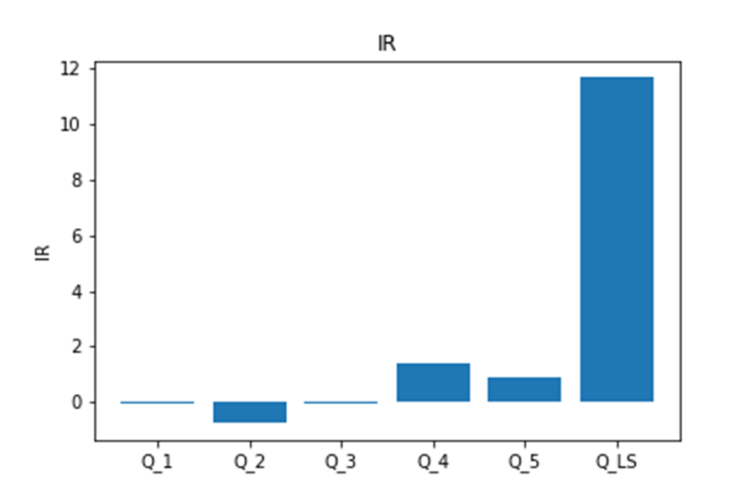
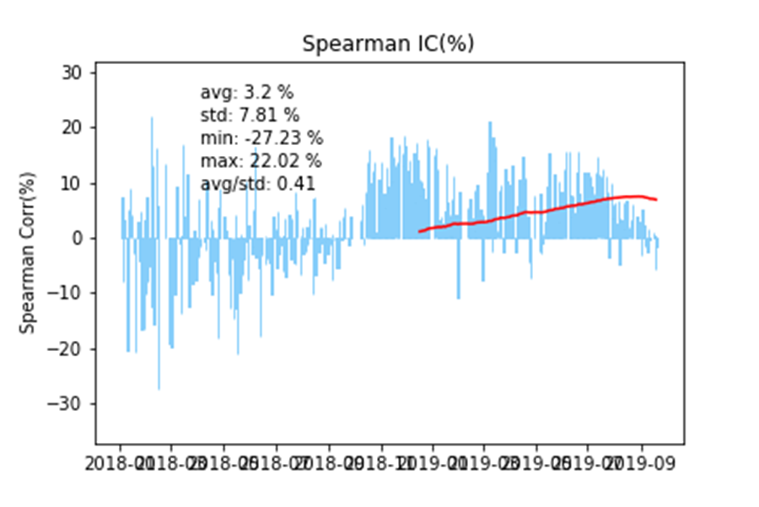
Evaluation
Back test – Sentiment_Conform

Slide 30
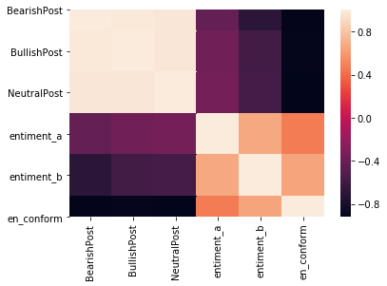
Evaluation
Correlation

Slide 31
Summary
PART SIX

Slide 32
Summary
Advantages
1. Used cutting-edge Transferring Learning algorithm
2. Strong practicability
3. Provides a relatively complete analysis process framework
Improvement
1. Insufficient data time span
2. The quantitative model is too simple
3. Insufficient labeled data

Slide 33
THANK YOU FOR WATCHING

